Slide 1
Improving Medical Code Prediction from Clinical Text via Incorporating Online Knowledge Sources
Source : ＷＷW’19
Speaker : Tzu-Yun, Chien
Advisor : Jia-Ling, Koh
Date : 2019/11/29
1

Slide 2
Outline
1
Introduction
2
Method
3
Experiment
4
Conclusion
2

Slide 3
Outline
1
Introduction
2
Method
3
Experiment
4
Conclusion
3

Slide 4
Prediction of Medical Codes
Results
predict
Clinical notes
( history of illness,
symptoms…)
4
Notes:
Clinical notes: History of illness, lifestyle, symptoms, treatment, medication.

Slide 5
Motivation
Rare code
249
Limited information
to recognize rare code
250
251
252
ICD-9 codes
5
Notes:
Clinical notes: History of illness, lifestyle, symptoms, treatment, medication.

Slide 6
Goal
Propose Knowledge Source Integration (KSI), a end-to-end code assignment framework, to integrate external knowledge during training of model.
To predict medical codes from clinical notes by taking advantage of online knowledge sources.
6
Notes:
Clinical notes: History of illness, lifestyle, symptoms, treatment, medication.

Slide 7
Outline
1
Introduction
2
Method
3
Experiment
4
Conclusion
7

Slide 8
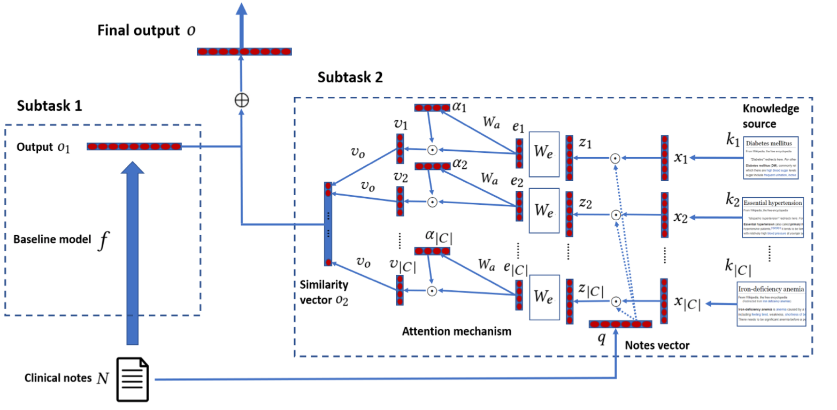
KSI Framework
8
Notes:
Clinical notes: History of illness, lifestyle, symptoms, treatment, medication.

Slide 9
KSI Framework
- Variables
$N$: Clinical note, which consists of a sequence of words
$W=\{w_{1, }w_{2,} …w_{\left|w\right|}\}$:
word vocabulary, where $\left|W\right|$ is the size of word vocabulary.
$C=\{c_{1, }c_{2,} …c_{\left|C\right|}\}$:
medical code vocabulary, where $\left|C\right|$ is the size of medical code vocabulary.
$K=\{k_{1, }k_{2,} …k_{\left|C\right|}\}$:
external knowledge source, which contains a set of documents
9
Notes:
Clinical notes: History of illness, lifestyle, symptoms, treatment, medication.

Slide 10
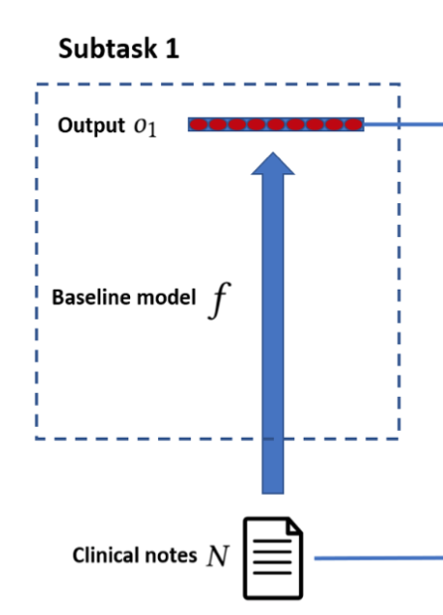
KSI Framework
- To directly predicts codes form notes
$$c_{1,}c_{2},……c_{\left|C\right|}$$
$$o_{1}=f(N)$$
$f$:
any end-to-end multi-label classification model
a vector $εR^{\left|C\right|}$, which represents the probability that medical code $c_{i}$ is the true label
$o_{1}$ :
10
Notes:
Clinical notes: History of illness, lifestyle, symptoms, treatment, medication.

Slide 11
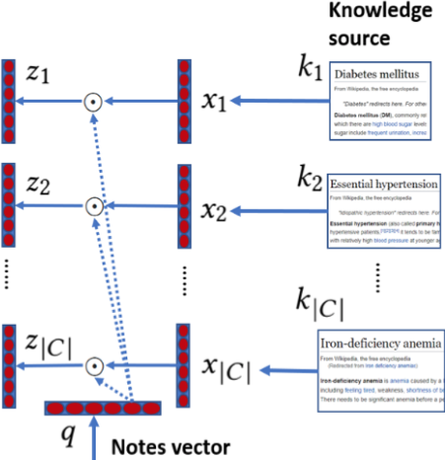
KSI Framework
- The intersection of two documents
$q$ : Clinical note N as binary vector $ε \{0,1\}^{\left|W\right|}$
$x_{i}$ : $k_{i}$ as binary vector $ε \{0,1\}^{\left|W\right|}$
$$z_{i}=x_{i}⊙q,{ z}_{i} ε \{0,1\}^{\left|W\right|}$$
11
Notes:
We discard irrelevant parts in two documents and focus common content

Slide 12
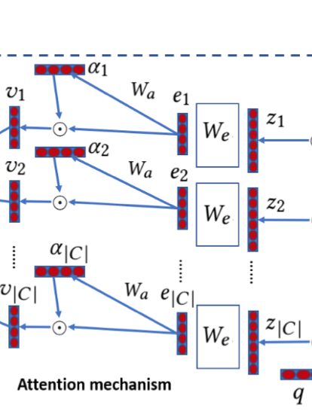
KSI Framework
- Attention mechanism
Transform vectors,
Use an embedding matrix $W_{e }ε R^{m×\left|W\right|}$
$m$ : dimensionality of the embedding space
$$e_{i}=W_{e}z_{i},{ e}_{i} ε R^{m}$$
Weight variables,
Use an weight matrix $W_{a }ε R^{m×m}$
$$a_{i}=sigmoid(W_{a}e_{i}),{ a}_{i} ε R^{m}$$
$$v_{i}=a_{i} ⨀{ e}_{i},{ v}_{i} ε R^{m}$$
12
Notes:
Transform

Slide 13
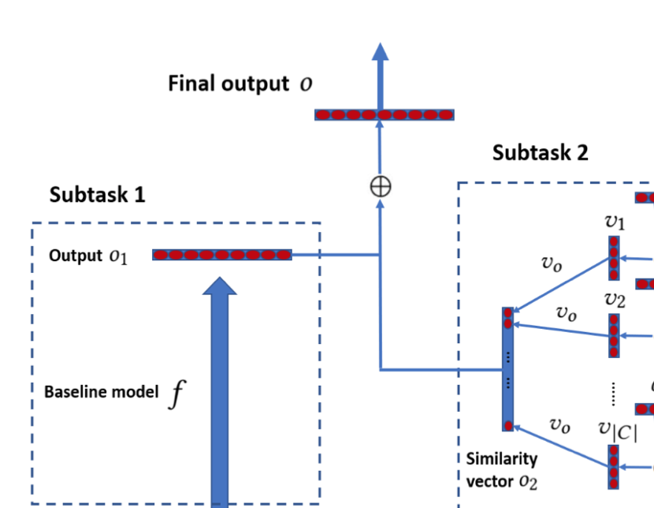
KSI Framework
- Similarity score and final output
Transform into similarity score,
Use a vector $v_{o }ε R^{m}$
$$s_{i}={v_{o}^{T}v}_{i}+{ b}_{o}$$
$$s_{1,}s_{2},……s_{\left|C\right|}$$
Concatenate $s_{i}$ to get $o_{2}$ and combine $o_{1 },$
$$o=o_{1}+o_{2}$$
$$\hat{y}=sigmoid(o)$$
13
Notes:
Transform

Slide 14
KSI Framework
- Loss function
Loss function(Binary cross-entropy loss)
$$L_{BCE}(N,y)={−(\sum_{i=1}^{\left|C\right|}{y_{i}}log⁡(\hat{y}}_{i})+\left(1−y_{i}\right)log⁡(1−{\hat{y}}_{i}))$$
$\hat{y}：$The predict label vector $ε R^{\left|C\right|}$
$y$ : True labels $ε \{0,1\}^{\left|C\right|}$
14
Notes:
Transform

Slide 15
Interpreting KSI framework
$$s_{i}={v_{o}^{T}v}_{i}+{ b}_{o}$$
$=v_{o}^{T}{(a}_{i} ⨀{ e}_{i})+{ b}_{o}$
$=v_{o}^{T}{(a}_{i} ⨀\sum_{j=1}^{\left|W\right|}{z_{i,j}}W_{e}[:,j])+{ b}_{o}$
$=\sum_{j=1}^{\left|W\right|}{v_{o}^{T}}{(a}_{i} ⨀W_{e}[:,j])z_{i,j}+{ b}_{o}$
$=\sum_{j=1}^{\left|W\right|}{v_{o}^{T}}{(a}_{i} ⨀W_{e}[:,j]q_{j})x_{i,j}+{ b}_{o}$
$$−>v_{i}=a_{i} ⨀{ e}_{i}$$
$${−>e}_{i}=W_{e}z_{i}$$
$$−>z_{i}=x_{i}⊙q$$
15

Slide 16
Outline
1
Introduction
2
Method
3
Experiment
4
Conclusion
16

Slide 17
Dataset
Clinical notes dataset：MIMIC-III
Online knowledge dataset：Wikipedia
Dataset | MIMIC-III | Wikipedia | Overlapped
# of notes (aggregated)/pages | 52722 | 389
# of words (aggregated) (per note/pages) | 1596 | 1058
# of words | 47965 (remove freque-ncy less 10) | 60968 | 12173
# of ICD-9 codes (grouped by first three digits ) | 942 | 389 | 344
17
Notes:
Transform

Slide 18
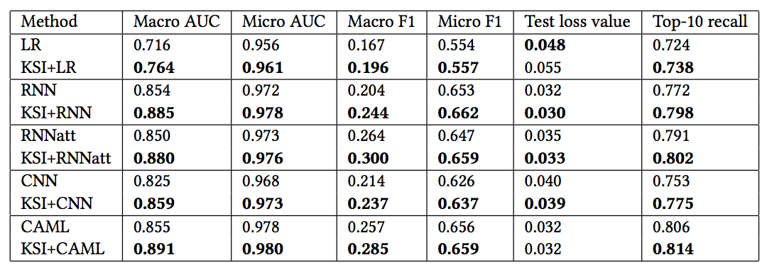
Results
- The predictive performance of baseline models alone and with KSI framework
Training, validation and test sets in a 0.7, 0.1, 0.2 ratio
4.8%
3.1%
3.0%
3.4%
3.6%
18
Notes:
For macro AUC: 4.8% for LR, 3.1% for RNN, 3.0% for RNNatt, 3.4% for CNN and 3.6% for CAML
Macro ： 計算均值時使每個類別具有相同的權重，最後結果是每個類別的指標的算術平均值。
Micro：計算多分類指標時賦予所有類別的每個樣本相同的權重，將所有樣本合在一起計算各個指標。

Slide 19
Results
Different methods perform on each medical code group (divided by label frequency )
19
Notes:
the rare codes lack examples and are bene ting greatly from the external sources.
we divide medical codes into 5 groups based on their frequencies in the dataset
An intersection of a note and a Wikipedia document can be viewed as a feature selection
it narrows down the feature space and makes it easier for the attention mechanism to find the evidence for the rare medical codes.

Slide 20
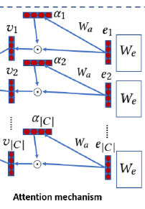
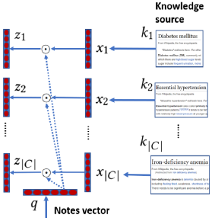
Results
The predictive performance of KSI and its variations
KSI-intersection
KSI-attention
20
Notes:
the rare codes lack examples and are bene ting greatly from the external sources.
we divide medical codes into 5 groups based on their frequencies in the dataset
An intersection of a note and a Wikipedia document can be viewed as a feature selection
it narrows down the feature space and makes it easier for the attention mechanism to find the evidence for the rare medical codes.

Slide 21
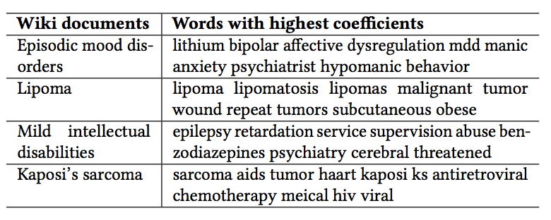
Results
Words with highest average coefficients for four disease Wikipedia documents
21
Notes:
KSI-intersection performs the worst on macro AUC, showing the importance of the intersection on inferring rare medical codes.
KSI-attention also underperforms KSI by 2.0% and 3.0% on macro AUC and macro F1, respectively, showing the effectiveness of attention mechanism on selecting important features for prediction.

Slide 22
Outline
1
Introduction
2
Method
3
Experiment
4
Conclusion
22

Slide 23
Conclusion
We propose a novel end-to-end framework to integrate external knowledge sources with any end-to-end baseline neural network model for the task of medical code prediction from clinical notes.
Our framework improves a variety of baseline models, and the improvement is particularly large on rare codes.
Our framework allows interpretability via analyzing attention values and weights of the model.
23

